Slide 1
L4/5 Group 4
Ripple Footie
Connor Wilby
Sam Clack
Henry Smith
Heather Bishop

Slide 2
The Current Iteration

Slide 3
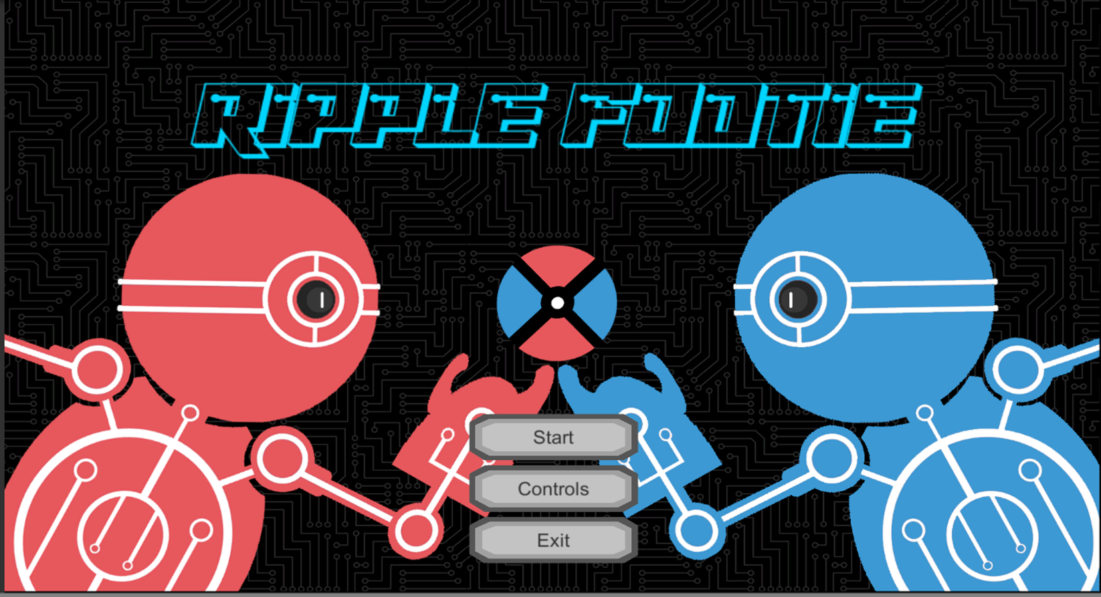
Currently implemented
Character movement
Main Menu
Scoring goals (and win condition)
Wave
End screens

Slide 4
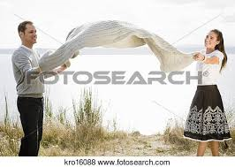
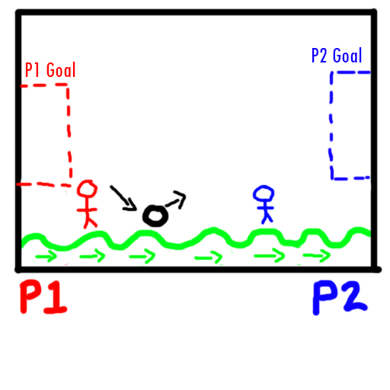
From Humble Beginnings

Slide 5
The game loop
Hit Ball
Score Goal
Reward

Slide 6
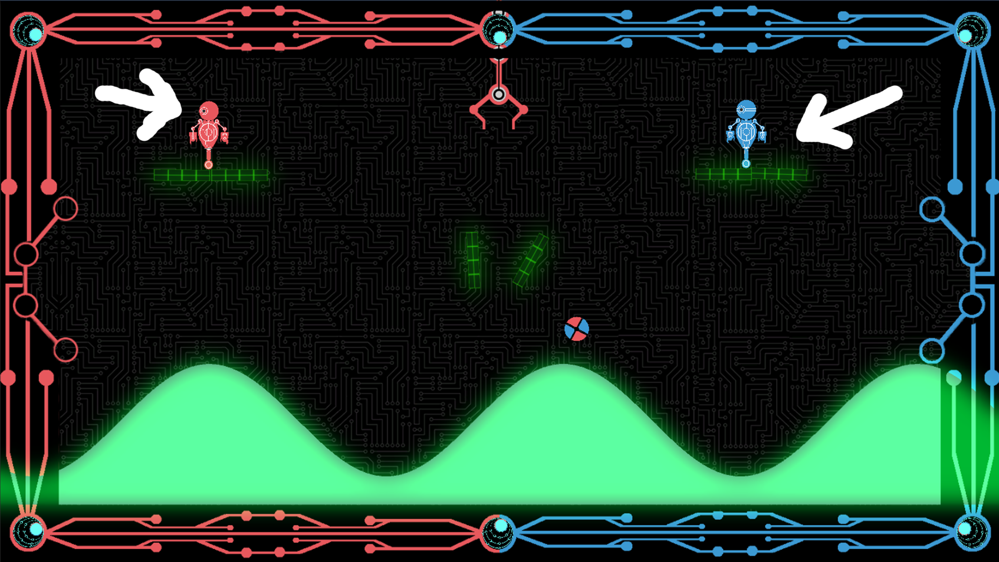
Keeping things fair
Gameplay is symmetric/simultaneous.

Slide 7

Chance vs skill
Unpredictability of the wave and jump.
Skill of timing ball hits and judging angles and distances of bounces.
Respite to regroup with platforms.
Judging best moment to use kick mechanic.

Slide 8
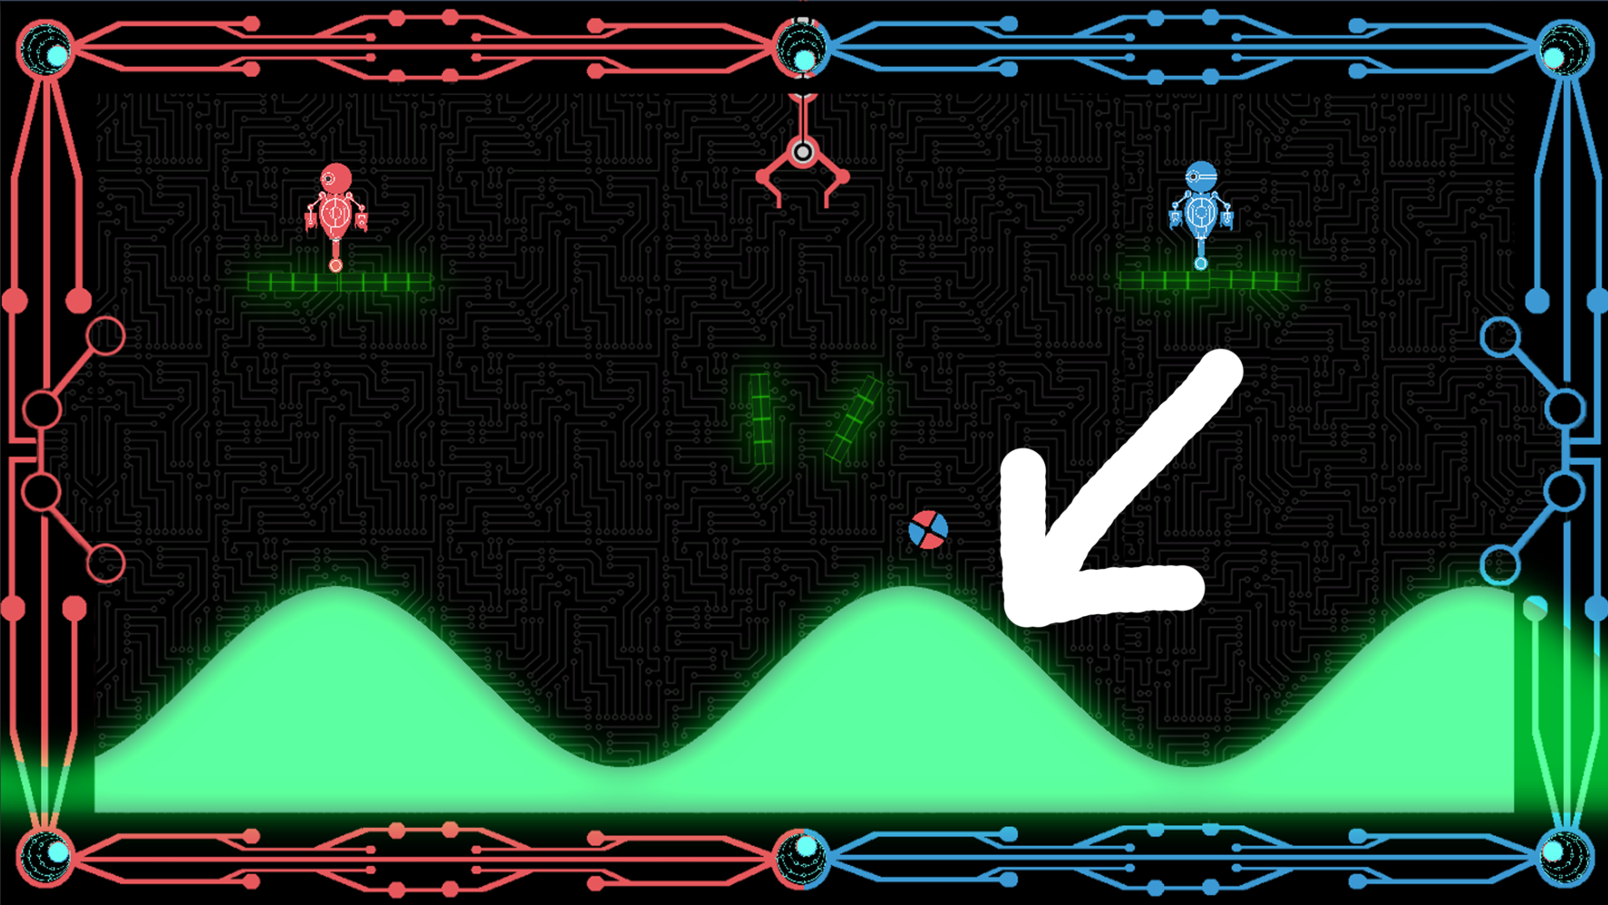
Physically Challenging
Physics generated by the terrain mimicking a wave.

Slide 9
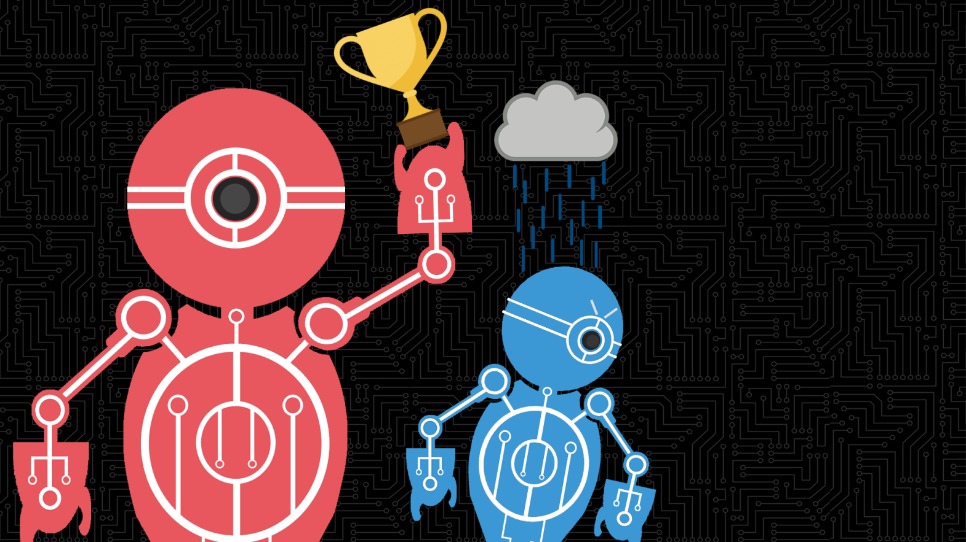
There can only be one
Adversarial: one user attempting to score enough goals to win

Slide 10
What makes us so special?
USP: The game takes a tried and tested formula for multiplayer and builds on it by making the terrain the true adversary.

Slide 11
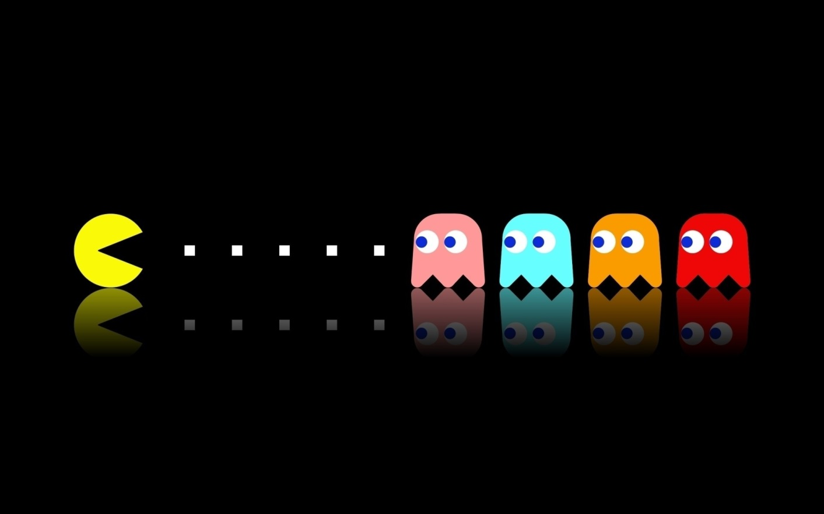
Keeping it simple
Art style, game play, UI.
Make the game as accessible as possible.

Slide 12



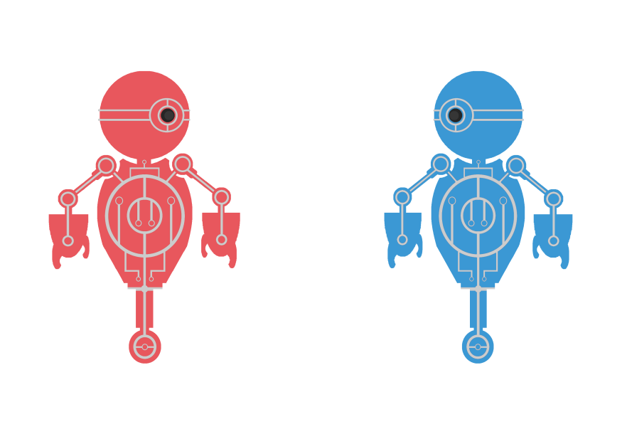
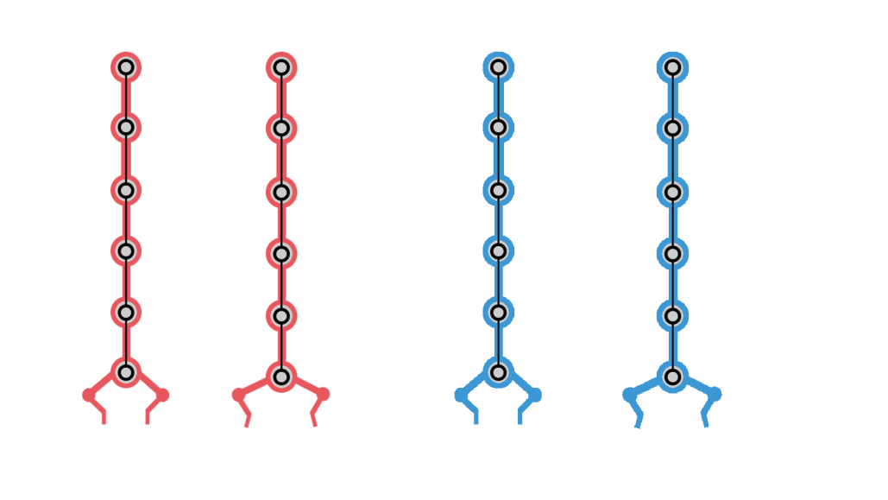
The art
Kept simple by using a consistent split-complimentary colour harmony (red, blue and green).

Slide 13
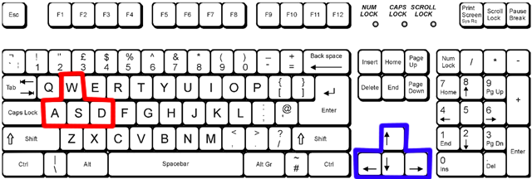
GamePlay
Both players use a keyboard to control their character

Slide 14
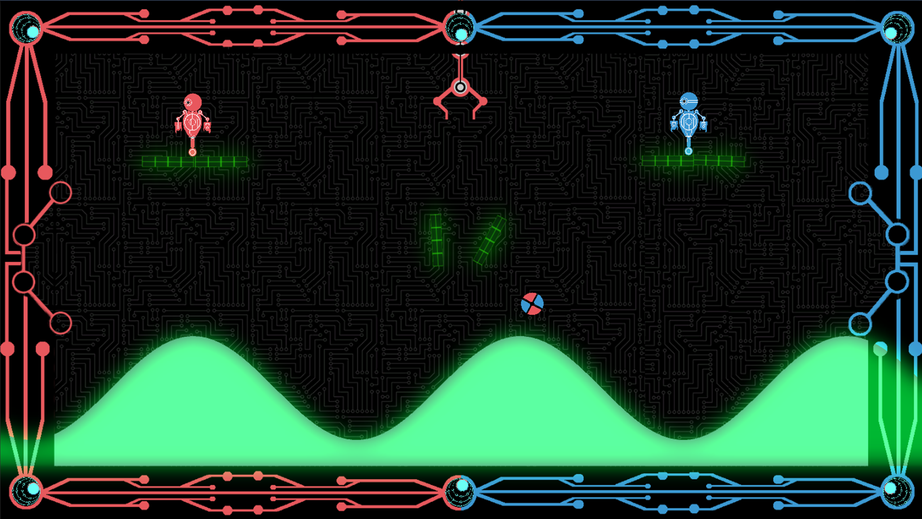
GamePlay Pt 2
Represent the objective as plainly as possible

Slide 15
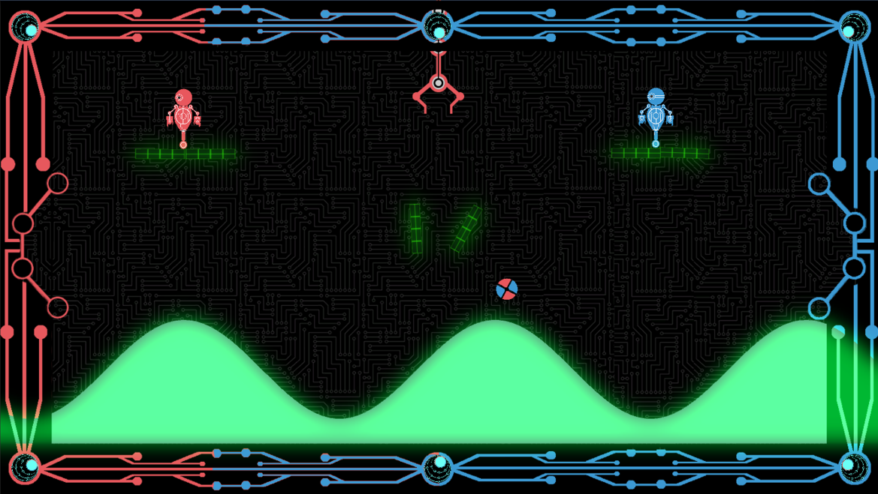
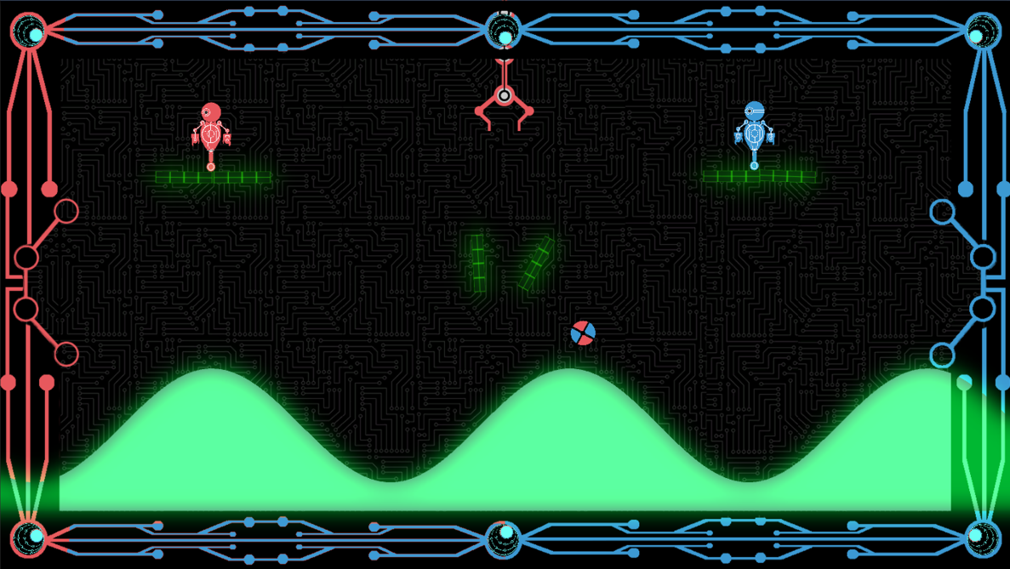
UI
Tug of war style scoring system that uses the foreground and a slider to display the score.
Nobody understood or noticed. In fact, it got a little awkward at times.

Slide 16
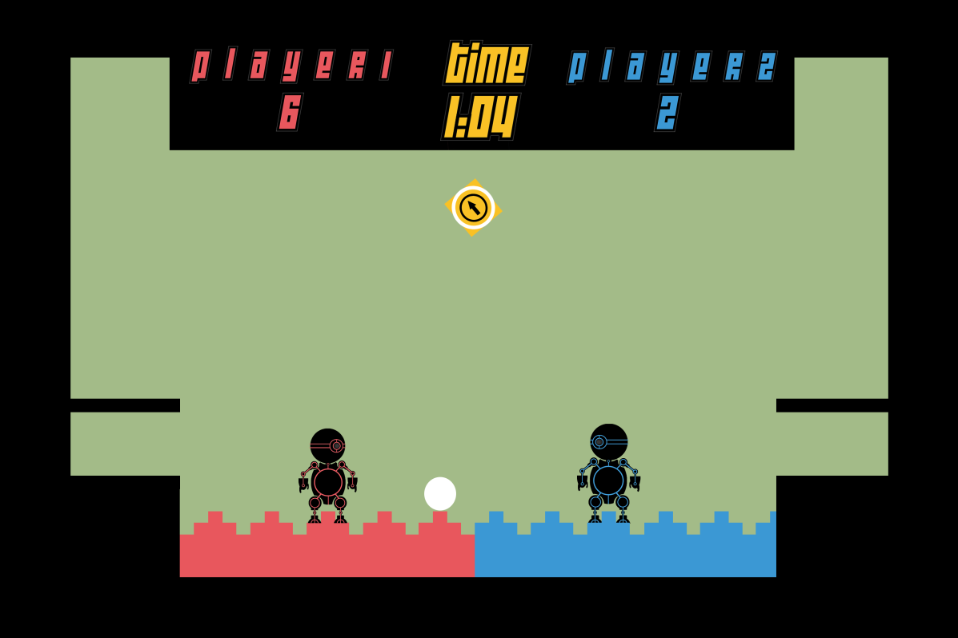
UI
Changed to a more standard numerical score display.
But retained the principle of the foreground responding to the score.

Slide 17
Aesthetics
Theme is using a mechanical vector style.

Slide 18

The
Foreground has been iterated many, many times.

Slide 19
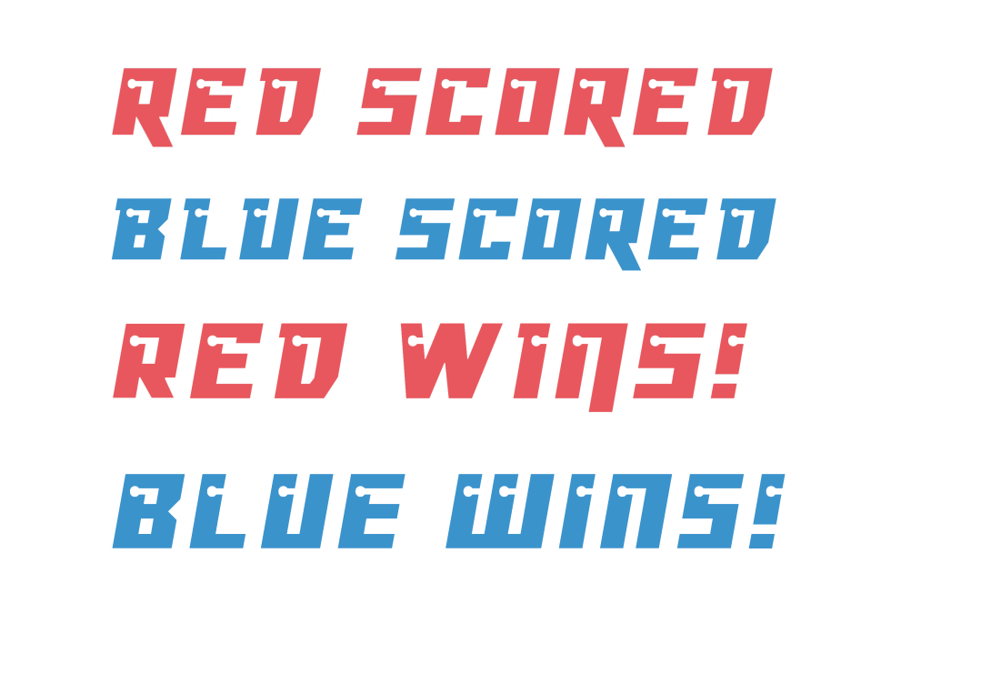
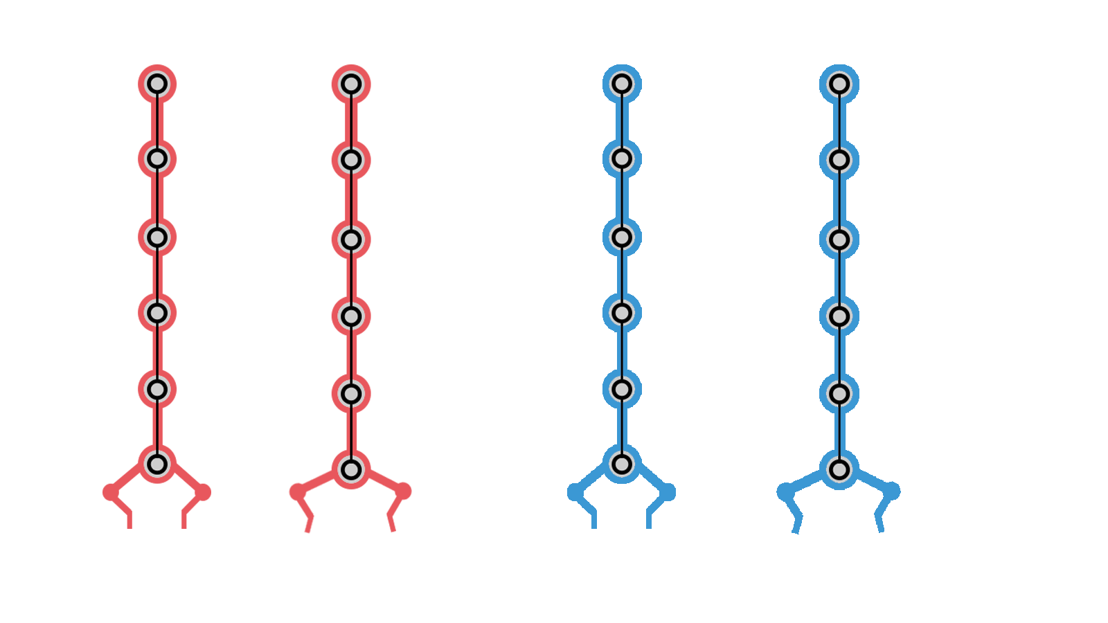
Visual Feedback
Popups.
Cam Shake
Explosions.
Ball explodes.
Claw descending from the top to “drop” the ball.
The foreground is part of
the UI.
Kick feedback

Slide 20
A Change Of Plans
Playtesting revealed that there was no visual narrative to tie all the elements together.
“Why am I here? Why am I competing with this person?”

Slide 21
A Change Of Plans
Created the narrative after receiving some sound advice.

Slide 22
Plan B visualised
Created the narrative after receiving some sound advice.

Slide 23
Panic And recant
However, due to some questionable prioritisation and time management we implemented what we had so far instead.

Slide 24
Sprint Information
Hours Logged
Connor:
Henry:
Sam:
Heather:
Emails Sent
Connor:
Henry:
Sam:
Heather:

Slide 25

Questions?

